Slide 1
Programming Guide to Disable DALI PSU

Slide 2
NFC Manual Scan
NFC Auto Scan
PRG-MUL2 Online program
PRG-MUL2 offline program

Slide 3
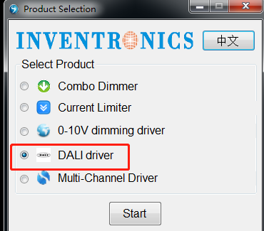
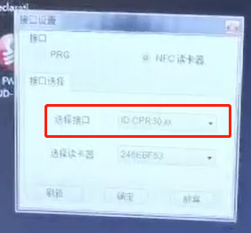
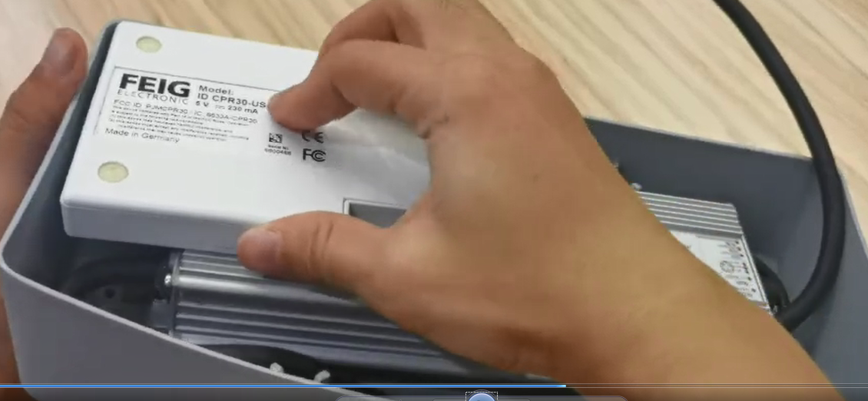
NFC Manual Scan
Connect NFC reader to laptop, open Inventronics Multi Programmer, select DALI driver and press start, tick NFC option, ensure the IP address is displayed.
Do not turn on AC power of Fixture, place screen side of NFC reader onto driver body till fastened, ensure NFC antenna of driver is covered by screen.

Slide 4
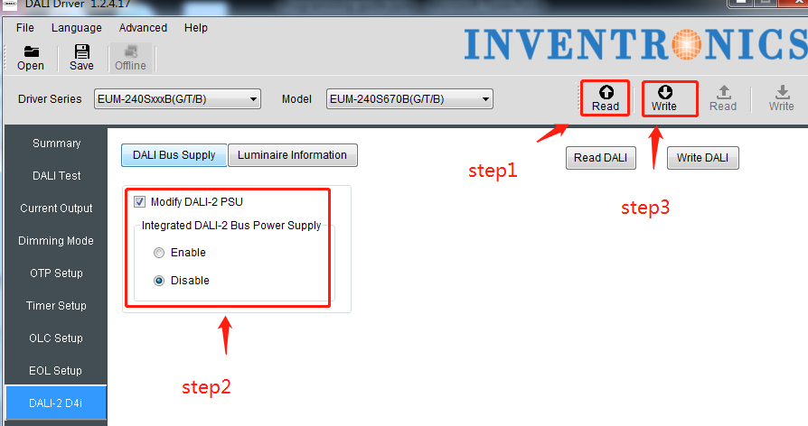
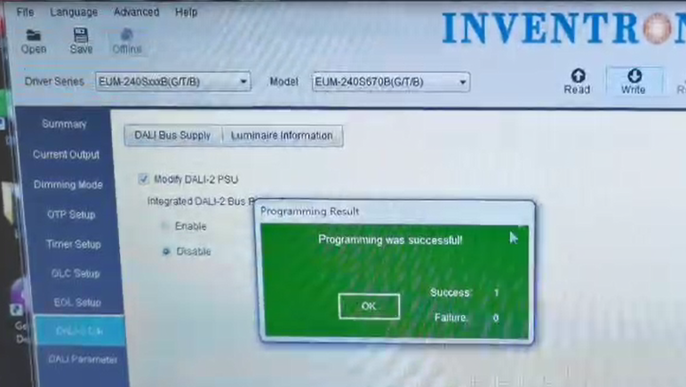
3. Follow below steps in programming interface, after that, you will see a window appear and remind you programming is successful.
Step1: Press Read
Step2: Press DALI2 D4i - tick Modify DALI-2 PSU - select Disable
Step3: Press write

Slide 5
NFC Auto Scan
Connect NFC reader to laptop, open Inventronics Multi Programmer, select DALI driver and start, tick NFC option, ensure the IP address is displayed.
Do not turn on AC power of Fixture, place screen side of NFC reader onto driver body till fastened, ensure NFC antenna of driver is covered by screen.

Slide 6
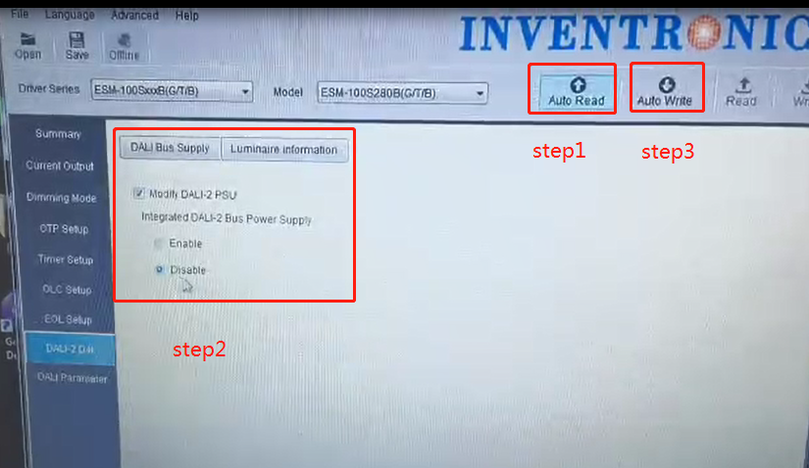
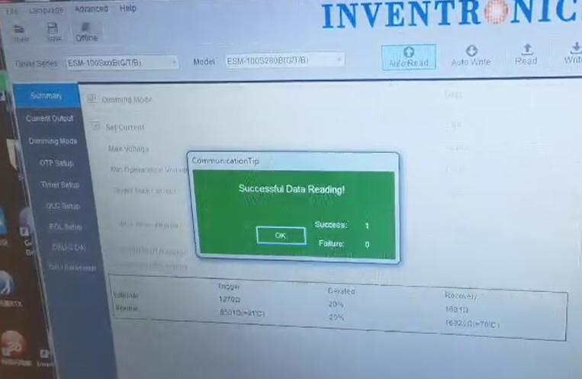
3. Follow below instructive steps in programming interface, after that, you will see a window appear and remind you programming is successful.
Step1: Press Advance-DALI Autoscan setting
Step2: Press Auto Read
Step3: Press DALI2 D4i - tick Modify DALI-2 PSU - select Disable
Step4: Press Auto Write

Slide 7
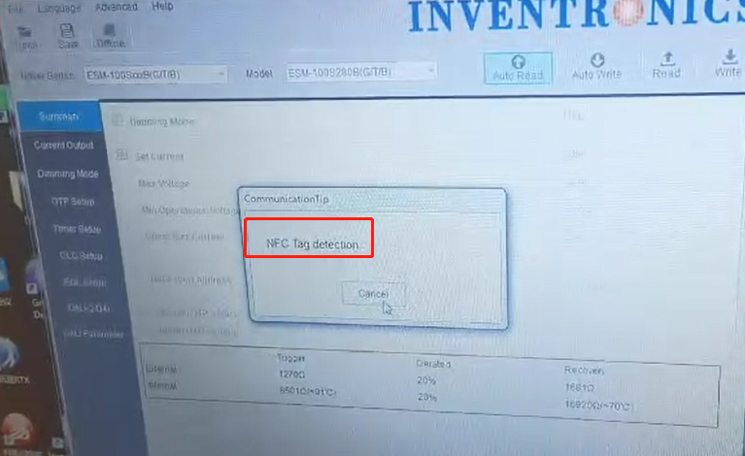
4. For the programming of more drivers, please directly place NFC reader on driver body as you did on first one, NFC reader will auto-scan and auto-program without any operation on laptop.

Slide 8
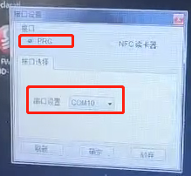
PRG-MUL2 Online program
Connect PRG-MUL2 to laptop and driver DALI wire, open Inventronics Multi Programmer, select DALI driver and start, tick PRG option, ensure COMXX is displayed.
Turn on AC power of Fixture before programming, follow below steps and finish the programming.

Slide 9
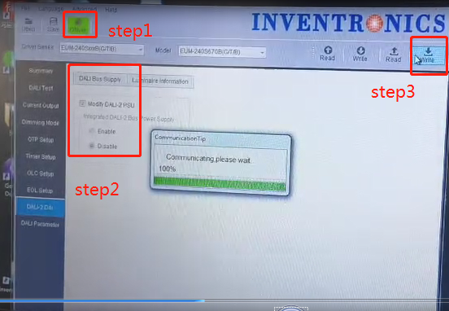
PRG-MUL2 Offline program
Connect PRG-MUL2 to laptop only, open Inventronics Multi Programmer, select DALI driver and start, tick PRG option, ensure COMXX is displayed.
In main page of programming interface, follow below steps to save setting into programmer.
Step1: Press offline, enter offline programming mode.
Step2: Press DALI2 D4i - tick Modify DALI-2 PSU - select Disable
Step3: Press write
After that, the setting is saved into PGR-MUL2.

Slide 10
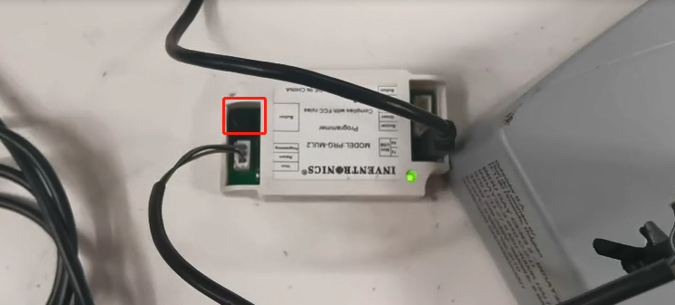
3. Disconnect between laptop and PRG-MUL2, instead connect PRG-MUL2 to a power bank or a 5v battery, keep PRG-MUL2 always powered .
4. Build up connection between PRG-MUL2 to driver , to start offline programming, press black button once, the green light will flashing for several times and finally always on, until now it means the offline programming for one driver is done.
5. For the offline programming of more drivers, do it same way as above operation.

